Slide 1

Final Project Presentation
Ayush Sharma
Saurabh Jangid
Mahendra Naik
Mithlesh Singh Bisht
Veeresh Raj Bahri
Vikalp Chauhan
Mohammed Saquib Ansari

Slide 2
Pixogram
PIXOGRAM is an all new social media application which let you connect with people, upload images & videos and explore what's going around.
The application comes with Sign In and Sign Up flows which mean that if you're new to the platform, you'll have to create your account first to get going and if you're an existing user, you just can log in to the application and begin exploring. You can upload images and gif, you can follow and unfollow other users and more. You can also block users and unblock them whenever you want. You can also experience newsfeed.

Slide 3

Project steps
When we will start the project it will come to the main page.
From there click on login if you are an existing user, else click on signup

Slide 4
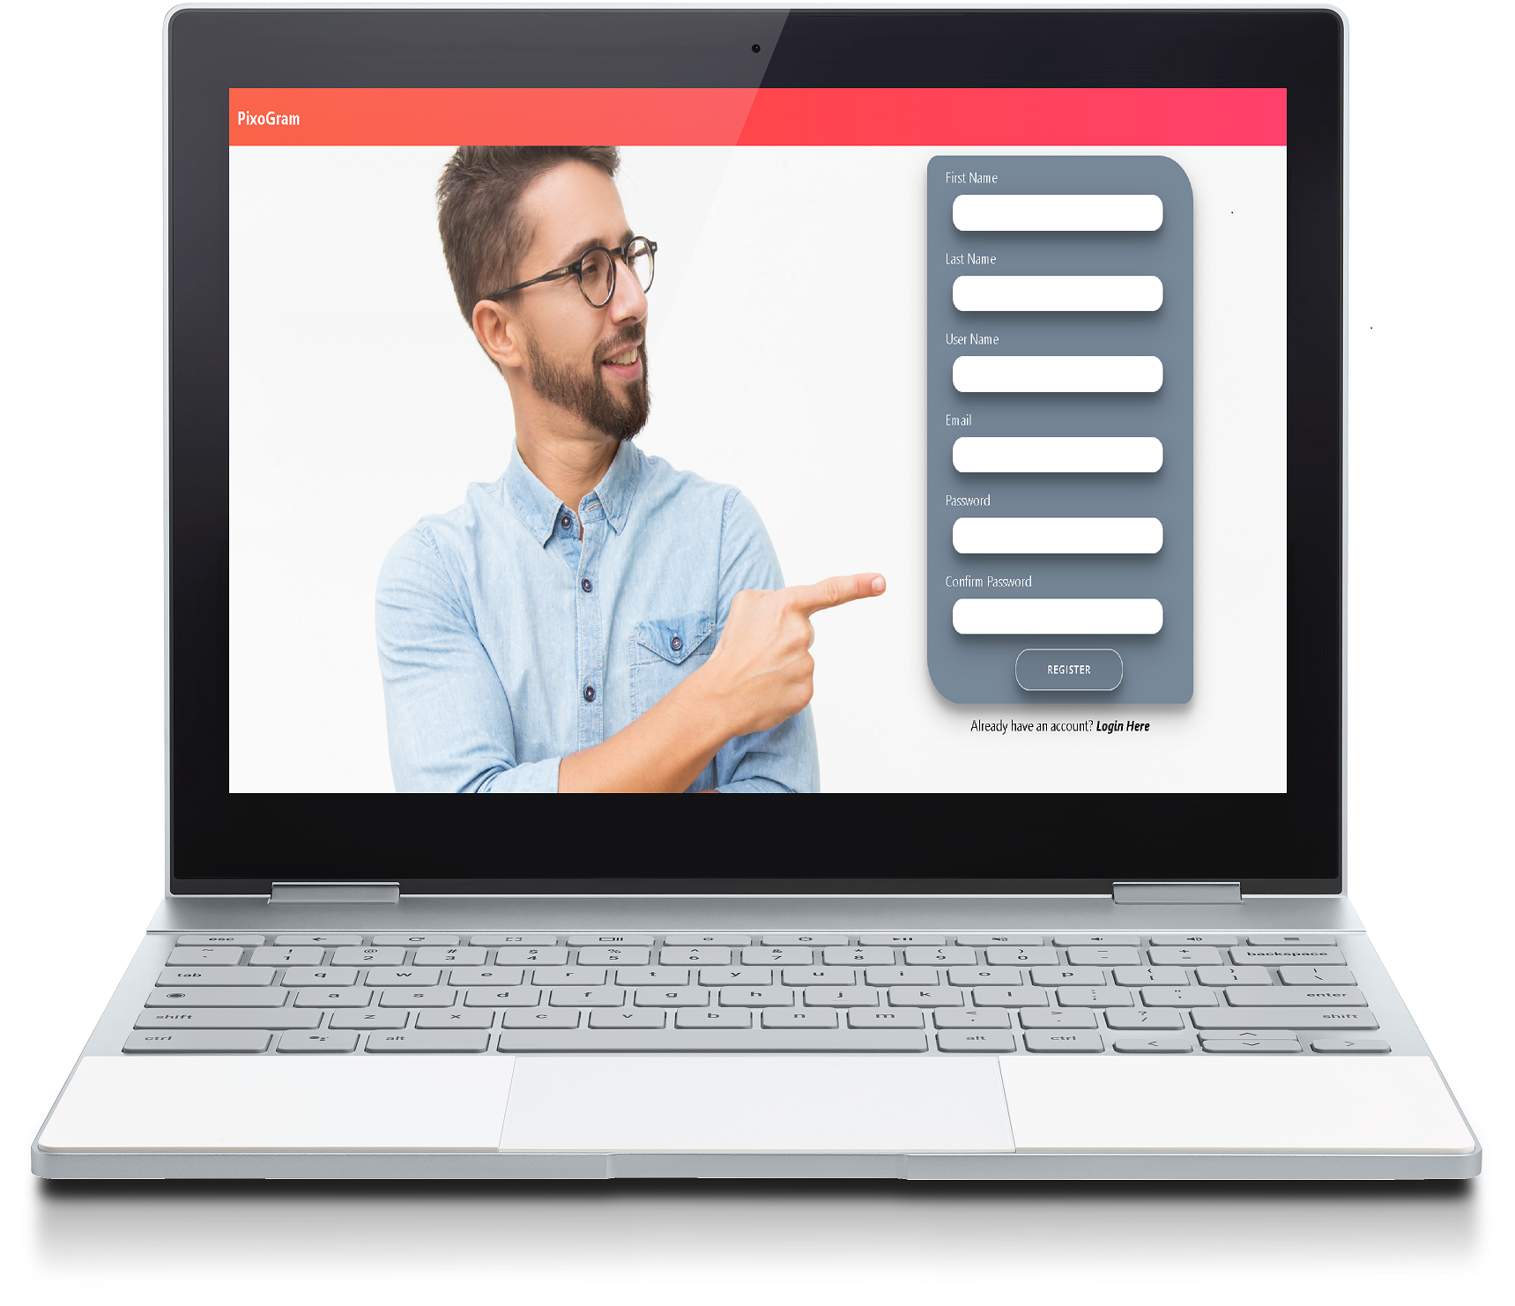
Steps continue…
Suppose you are a new user then from the main page click on SignUp and the page for registration will appear.

Slide 5
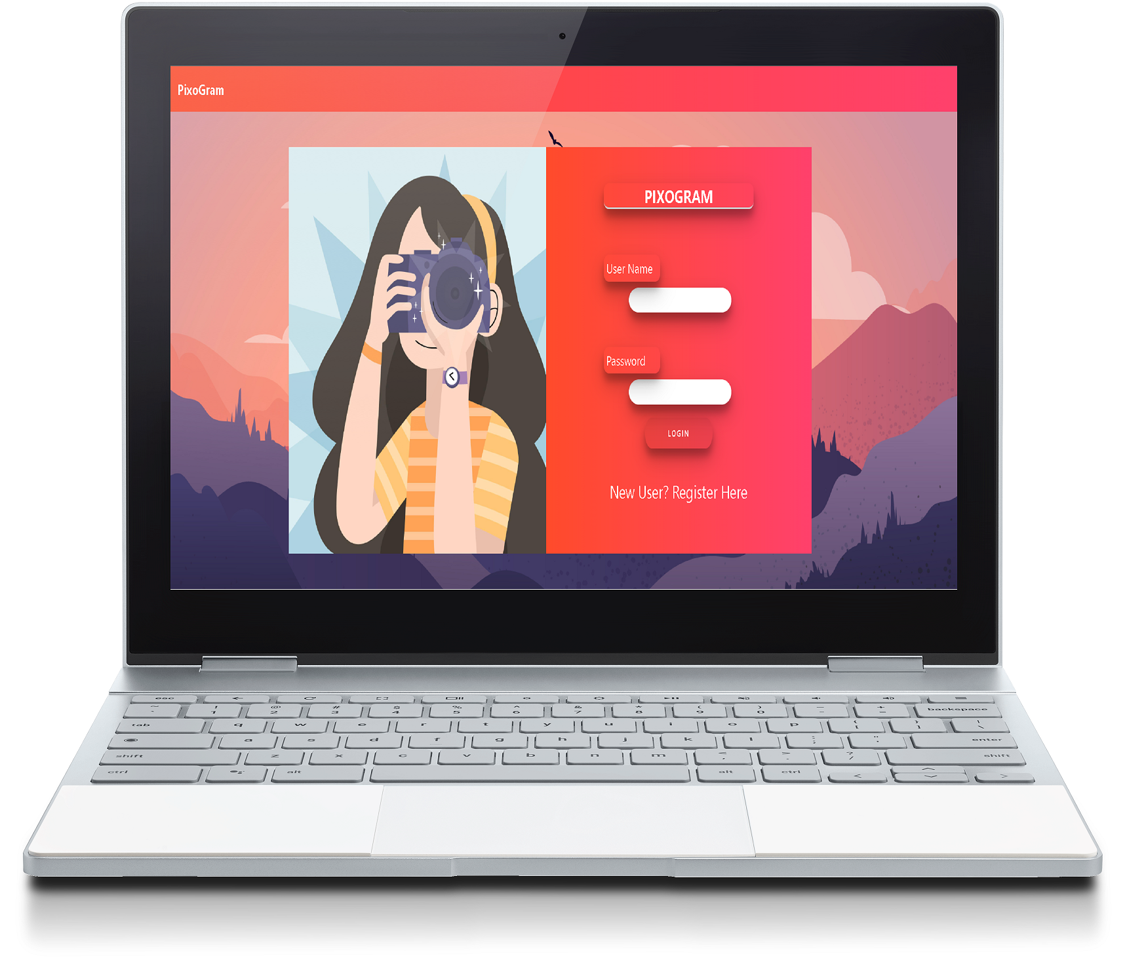
Continue…
After Successfully registered, the login page will appear.
Here you can enter your username and password.

Slide 6
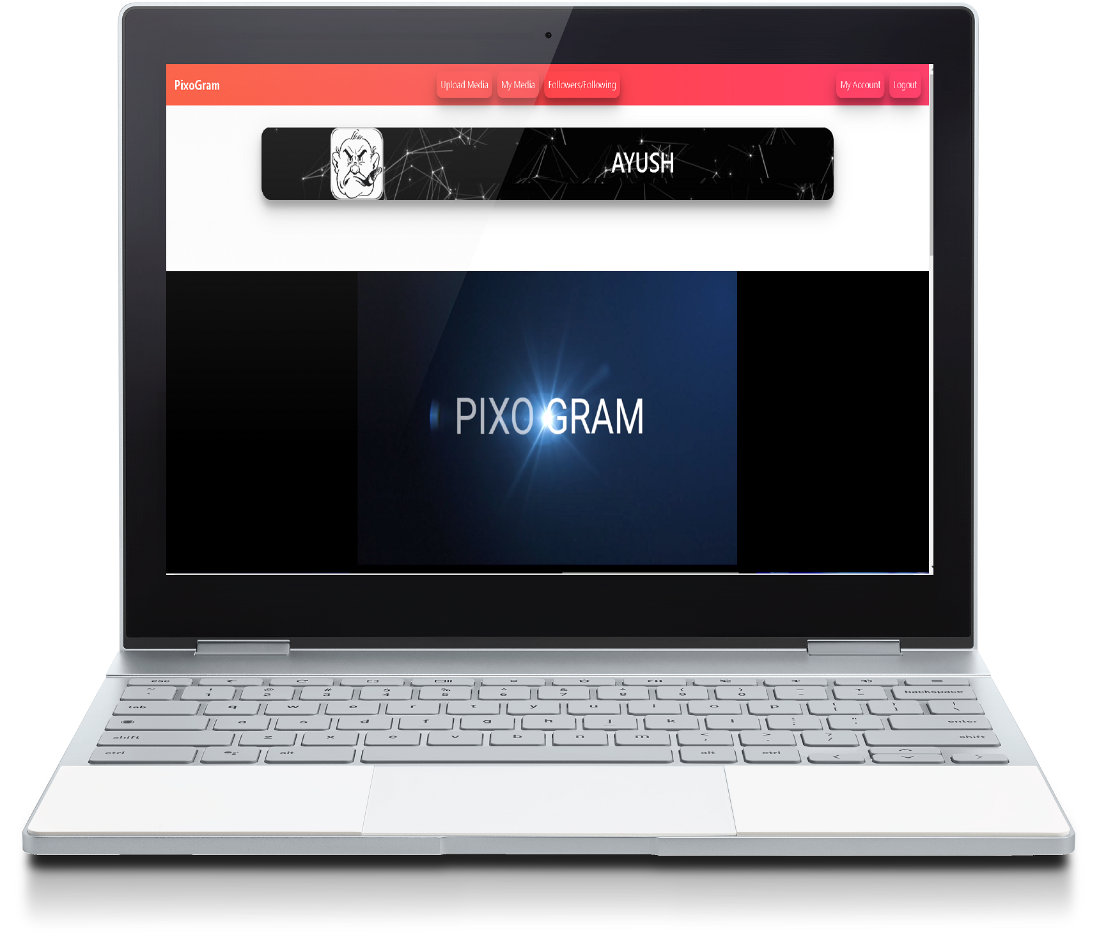
Continue…
After successfully login, user homepage will be redirected.

Slide 7
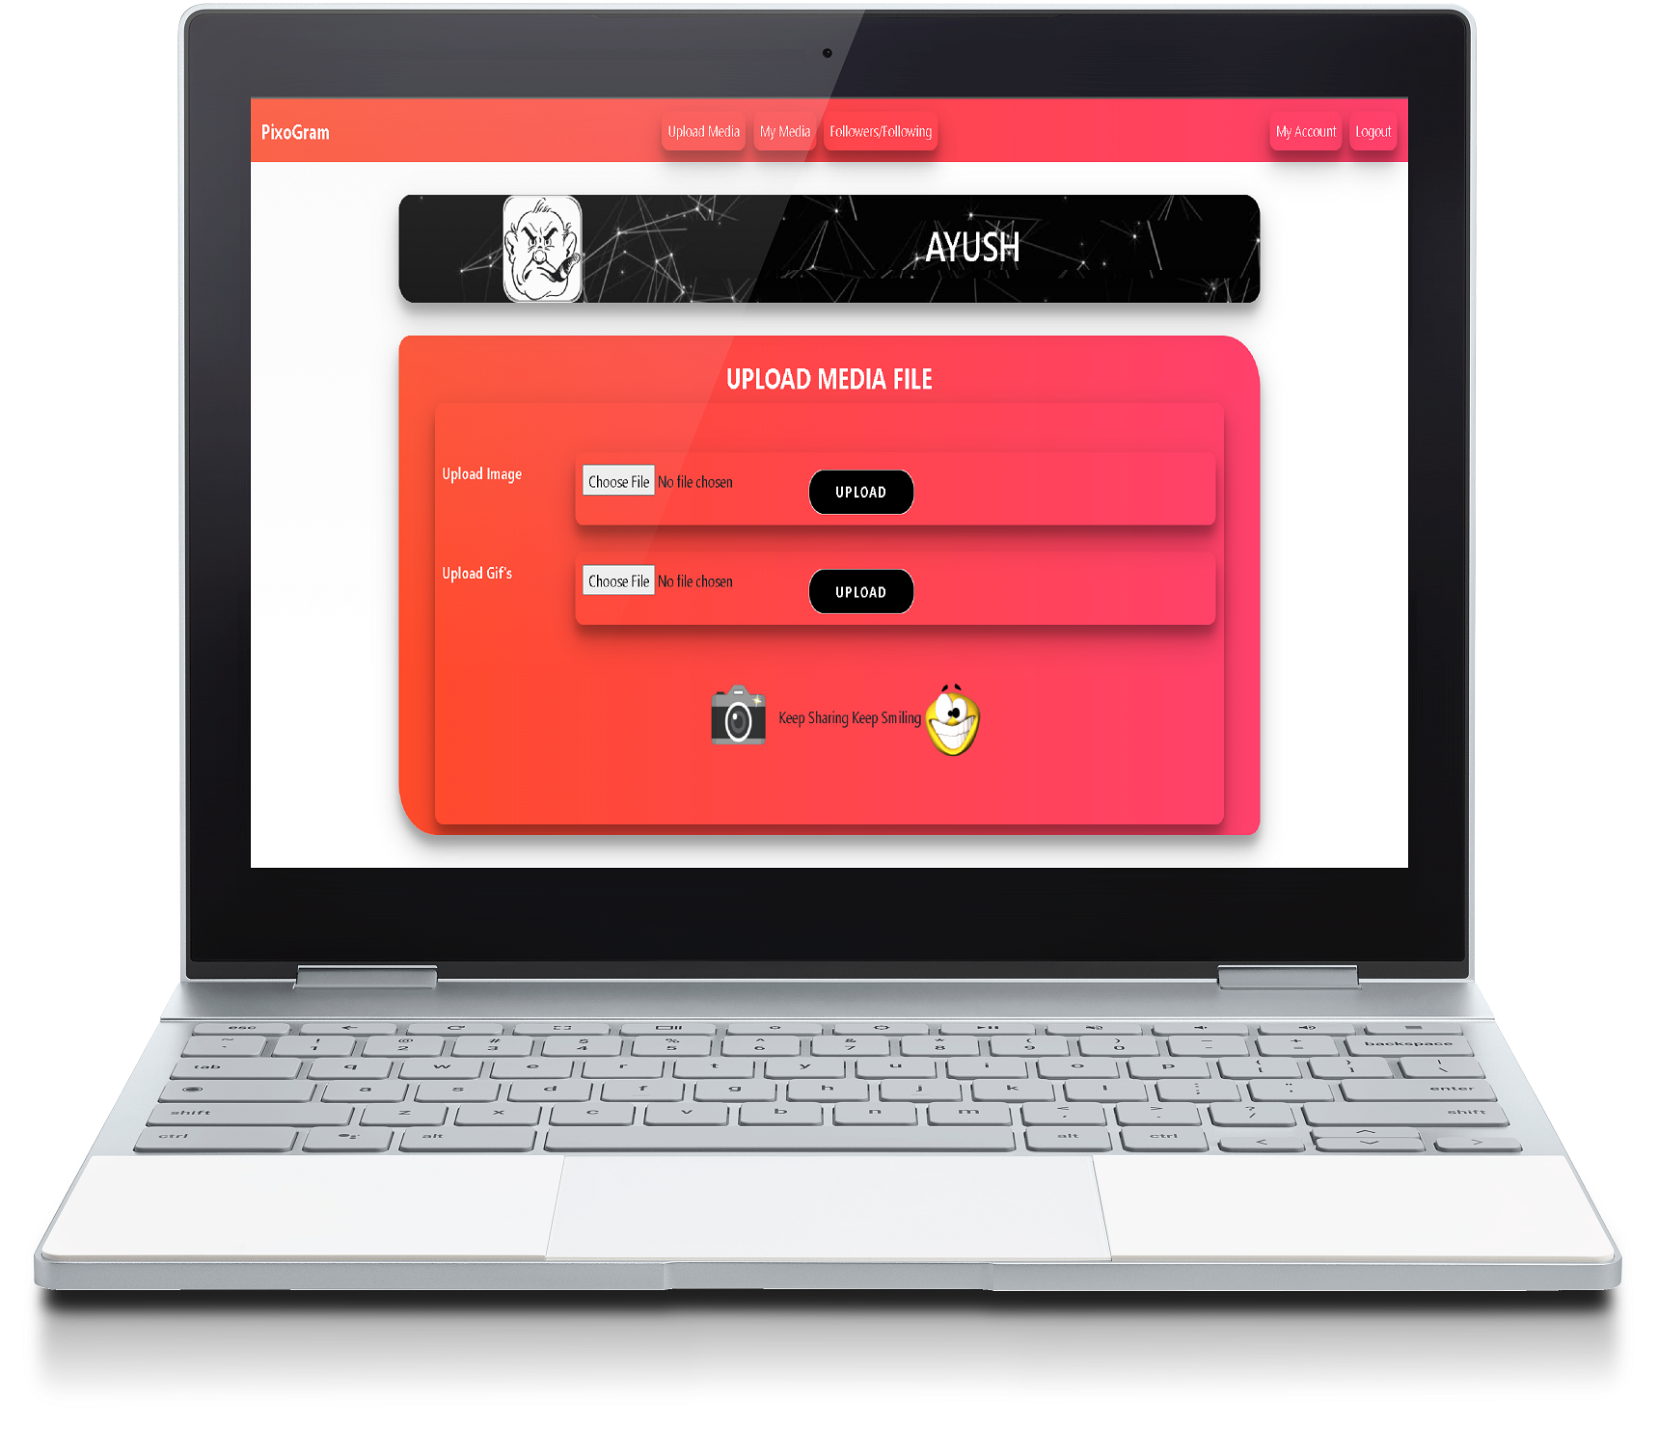
Continue…
We can upload images and gif from the upload feature.

Slide 8
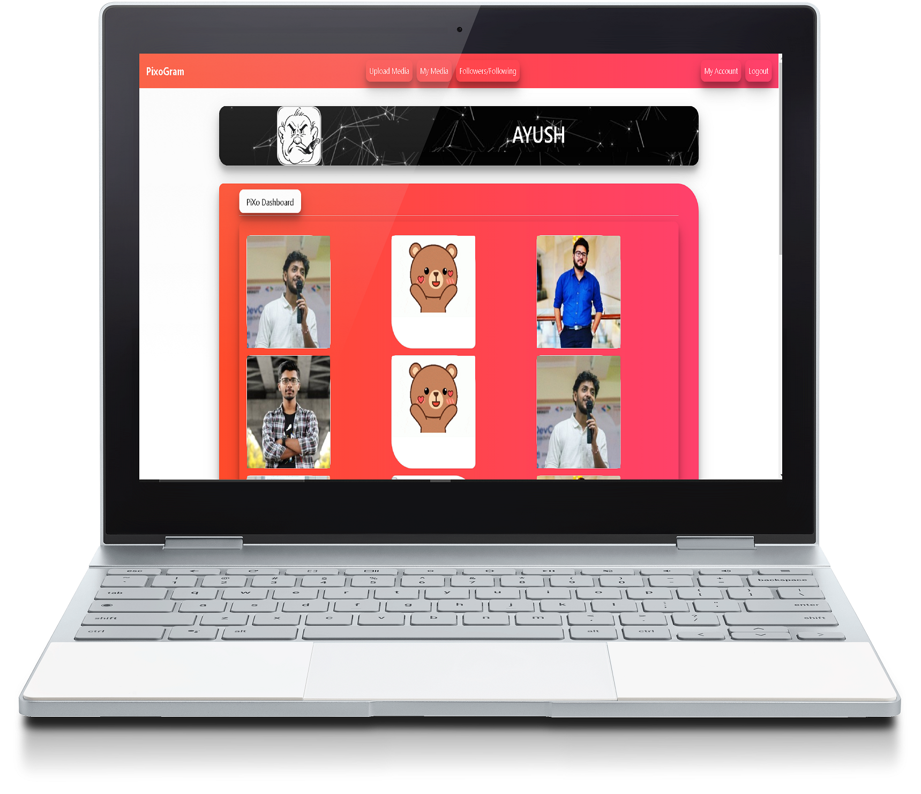
Continue…
All the uploaded media will be seen in Mymedia feature.

Slide 9
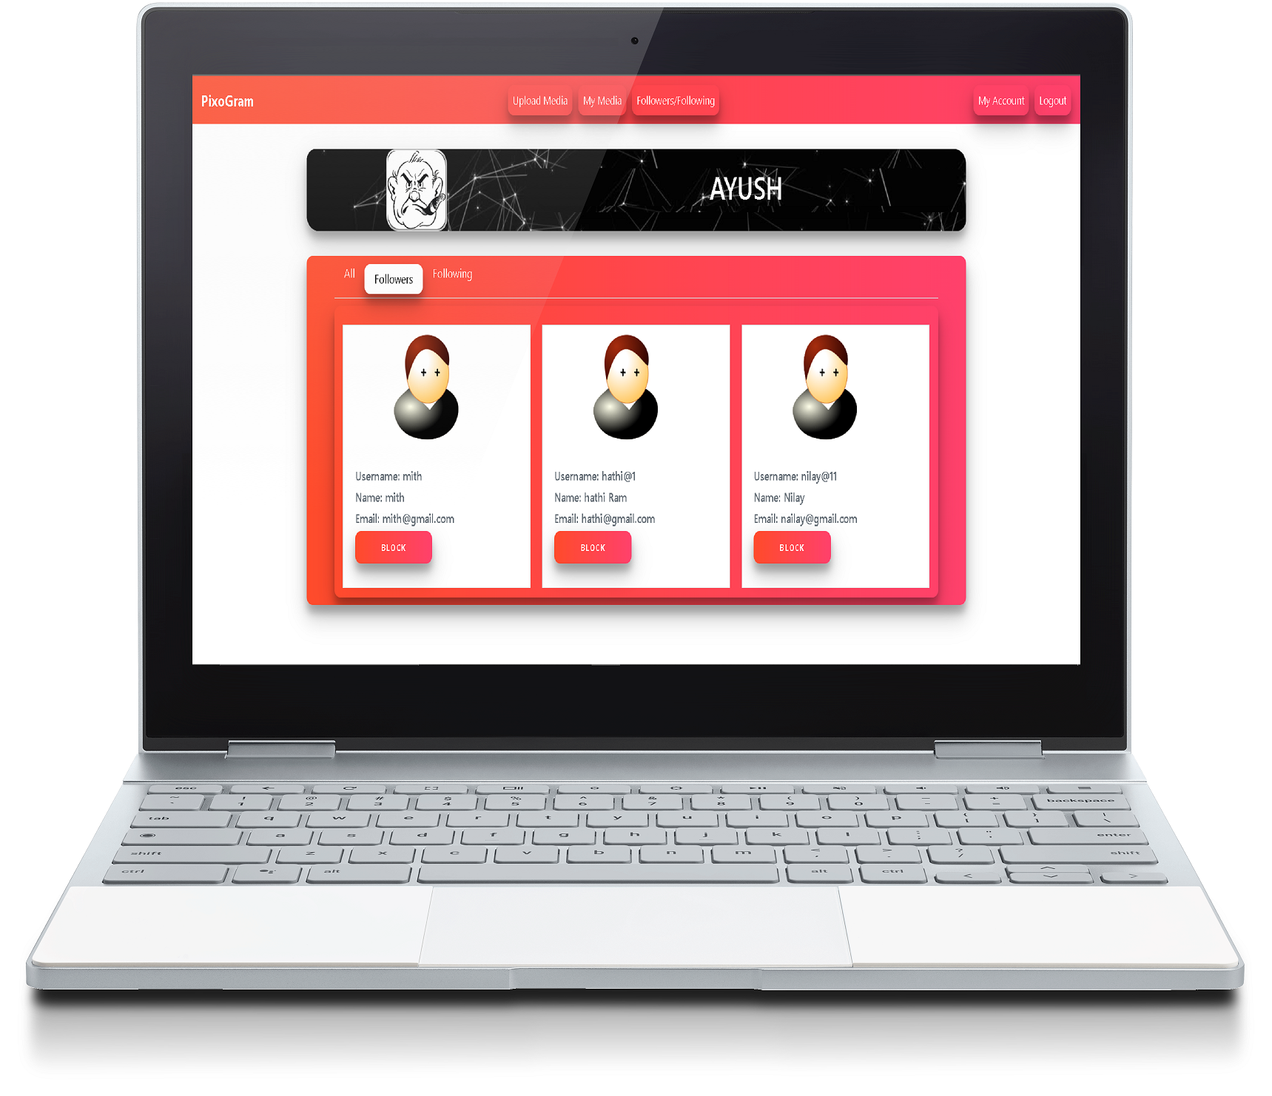
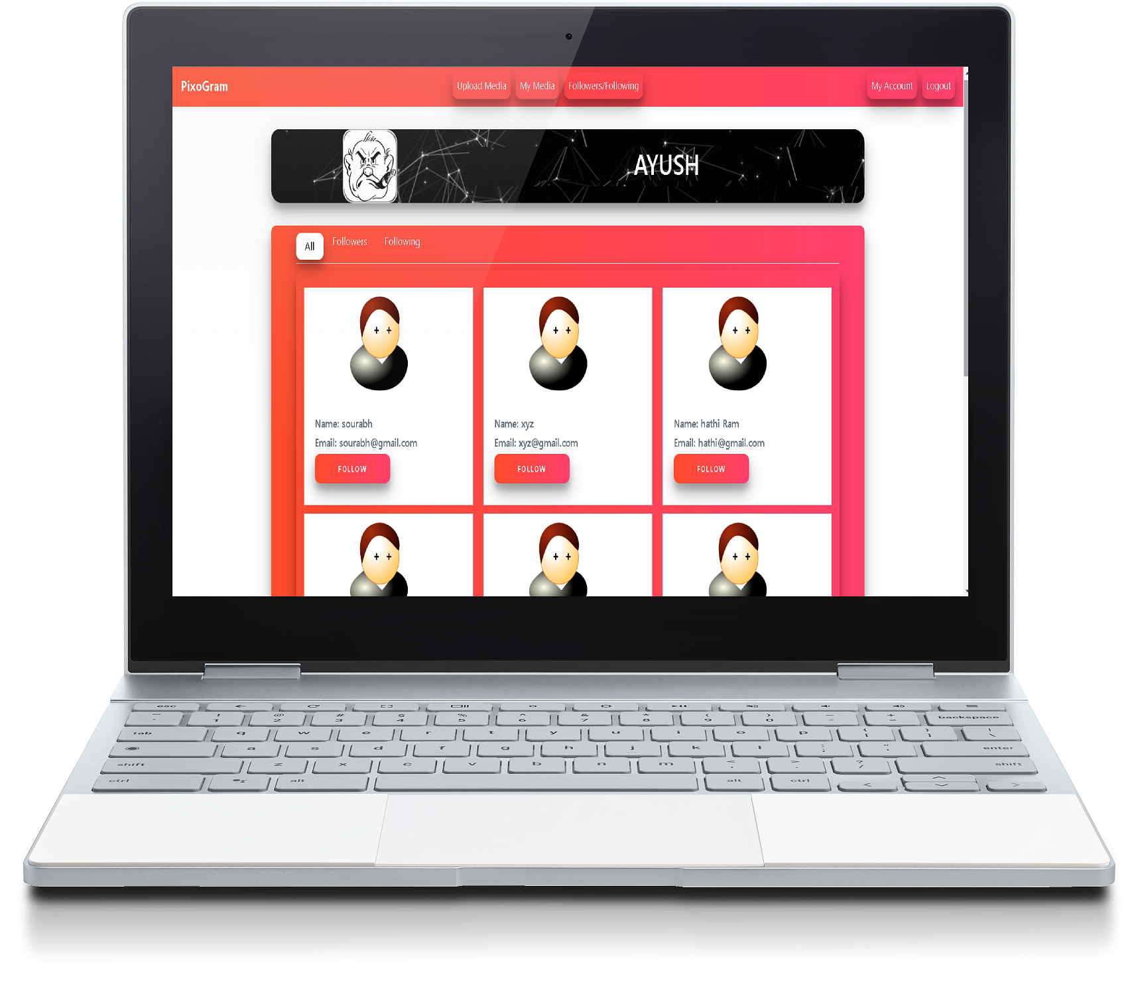

Continue…
Another feature followers/following, on clicking this an user can get all the users and also can see the followers and following of him/her.
Follower All Users Following

Slide 10
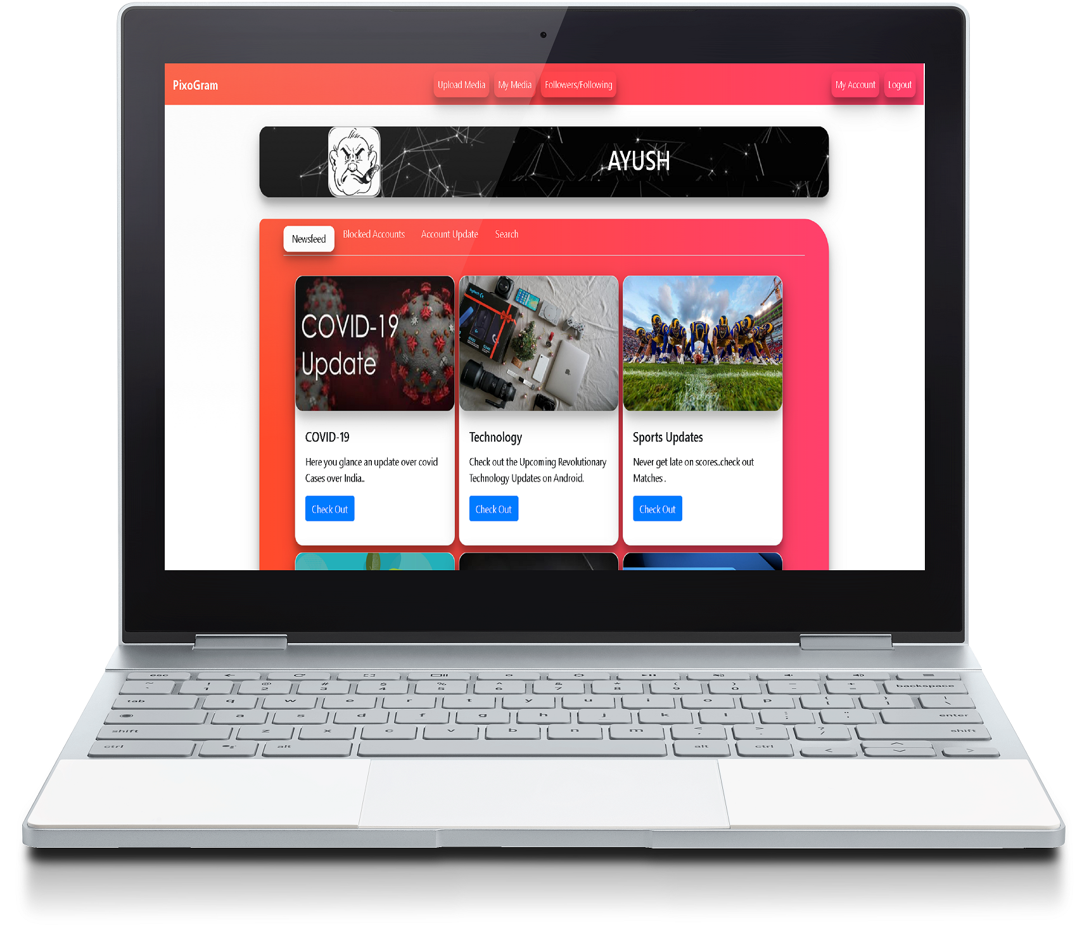
Continue…
After followers/following, an user can read daily newsfeed in PixoGram which comes under MyAccount.

Slide 11
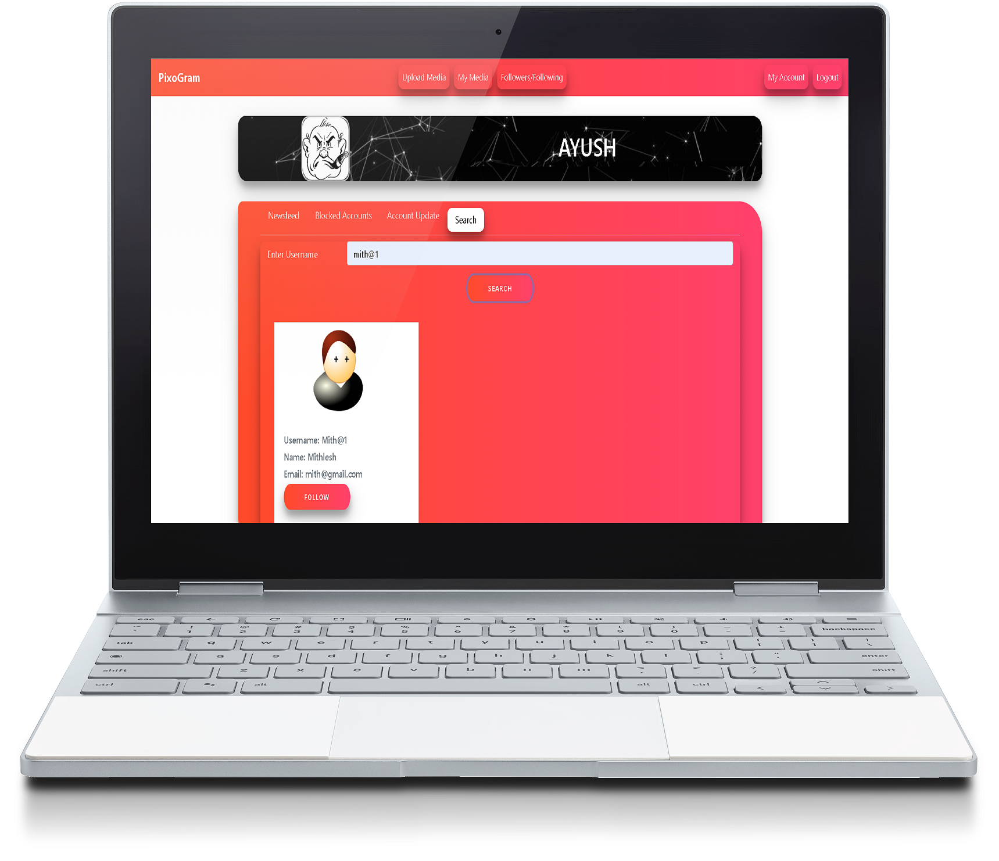
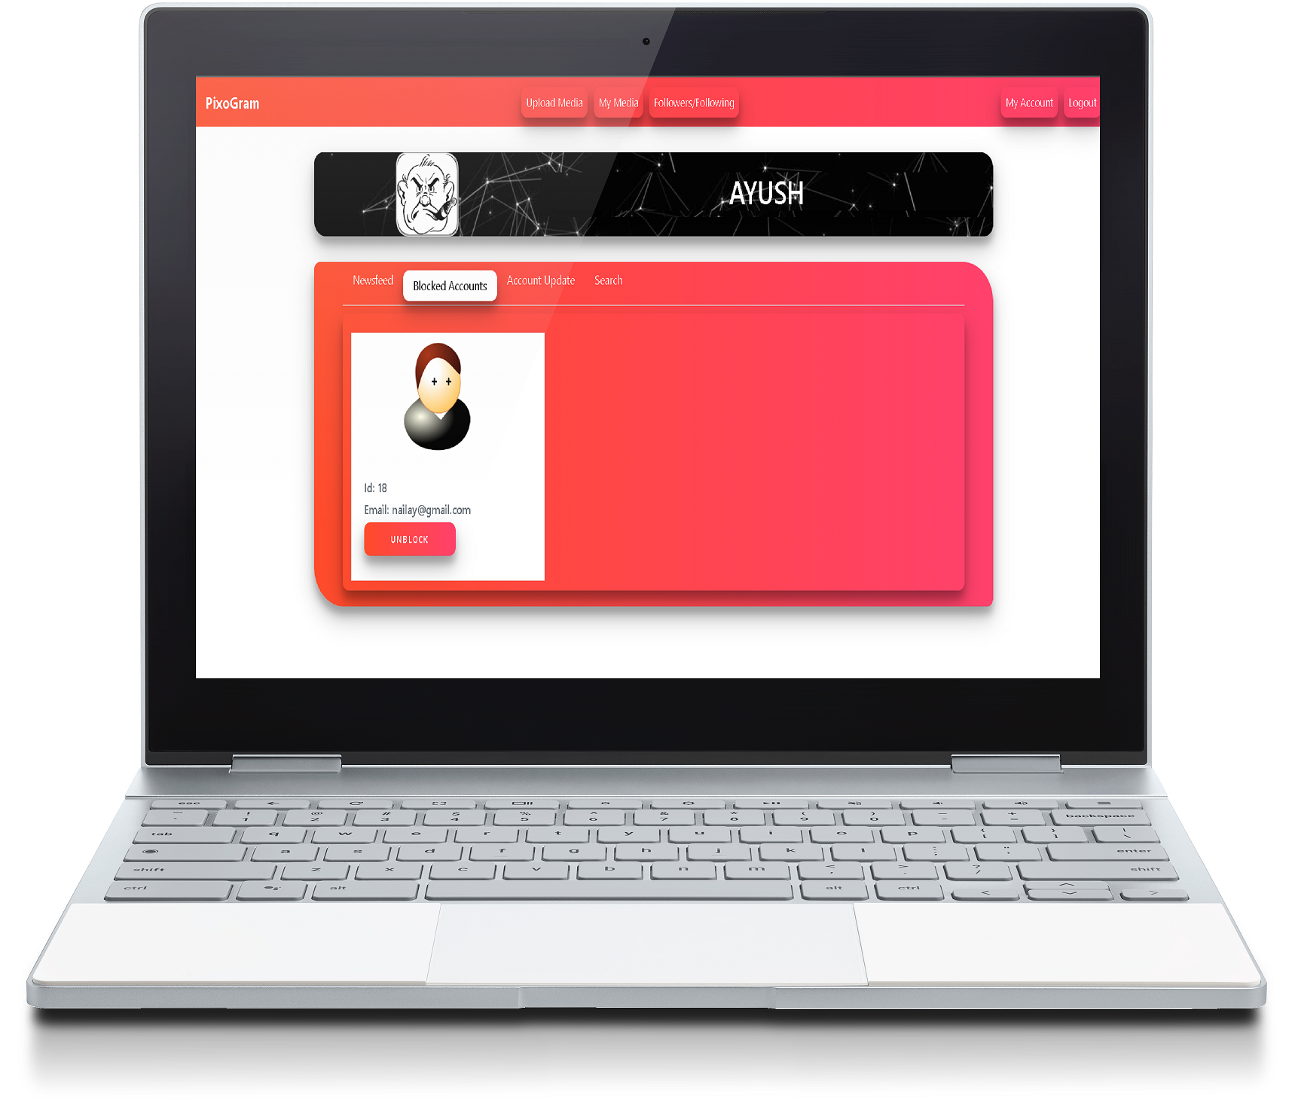
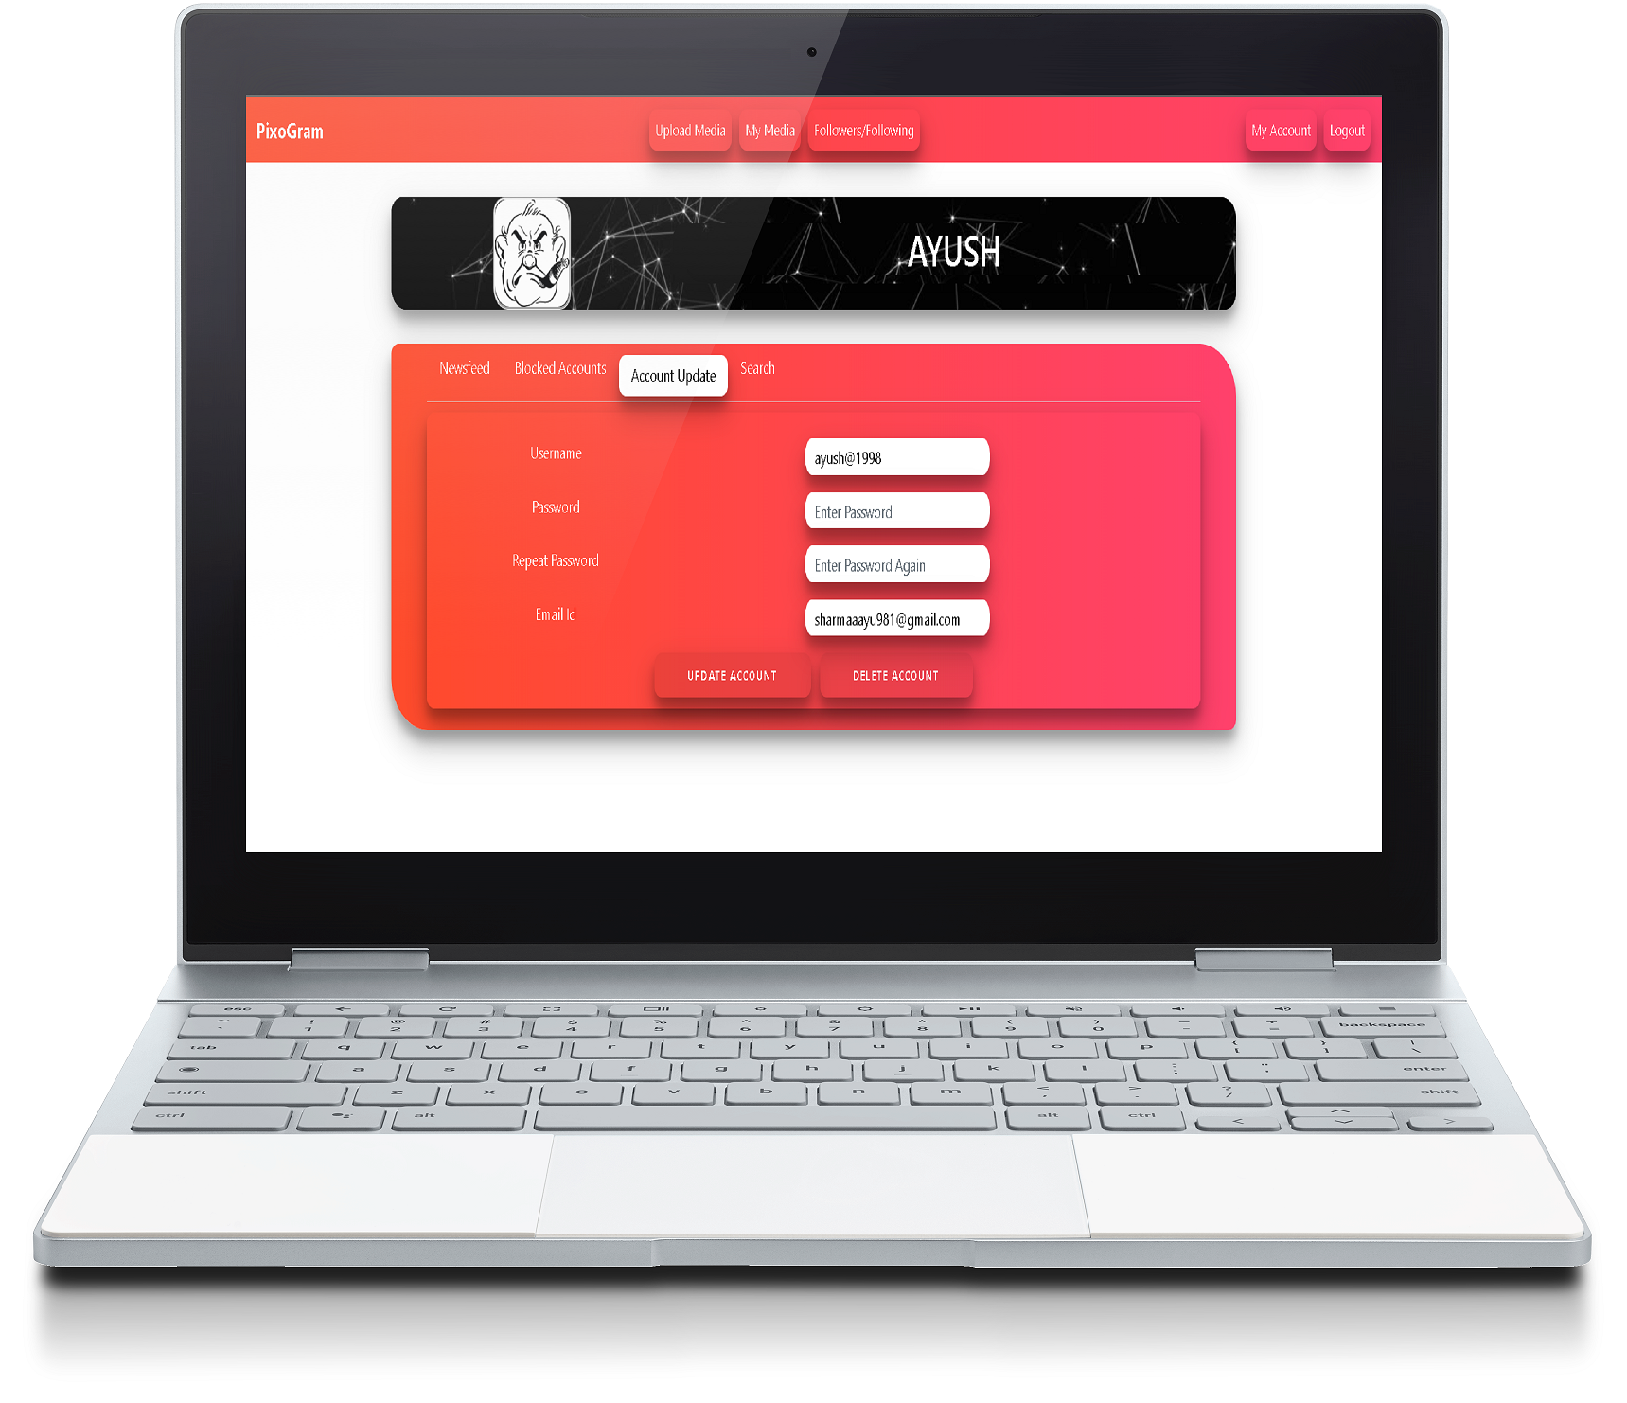
Continue…
From MyAccount an user can block other user, update password, delete his account and can search users.
Search User Block User update and delete

Slide 12
Thank You

